Slide 1
Matrix factorization techniques for recommended systems
Yehuda Koren, Yahoo Research
Robert Bell and Chris Volinsky, AT&T Labs-Research
Notes:
Hello everyone, the topic of our presentation is matrix factorization techniques for recommendation. The authors are currently from Yahoo Research and AT&T Labs-Research

Slide 2
Agenda:
1: Paper Background – Netflix Challenge
2: Collaborative filtering: Neighborhood method and Latent factor models
3: Basic matrix factorization model
4: Learning algorithms
5: Adding biases, additional input source and other aspects
6: Conclusion
Notes:
This is the structure of our presentation. I will introduce the background and general strategy of movie recommendation system. Huazheng will look into model details of the paper and Yuting will introduce how to embed more factors to basic model.

Slide 3
Netflix Challenge
Movie recommendation competition.
Author won the grand Netflix prize of one million!
Paper aims to produce product recommendations, allowing the incorporation of additional information including implicit feedback, temporal effects and confidence level.
High citation over 2000.
Notes:
I believe all of you have heared about the Netflix challenge before. This is a movie recommendation system competition for predicting how a user will rate a movie based on past records. The author of the paper won the 1 million first prize and their methodology is in the paper we are presenting. Netflix provided a training data set of 100,480,507 ratings that 480,189 users gave to 17,770 movies.

Slide 4
Recommender system strategy
1: Content Filtering: creates a profile for each user or product to characterize its nature.
The basic assumption is that users who had similar tastes in the past will also have similar tastes in the future.
Notes:
There are two types of recommendation strategy. The first kind of recommender system strategy is content filtering. The basic idea is to create profile for each user and move. For example, for movies we could look into the author, keywords and relation information.

Slide 5
Recommender system strategy
2: Collaborative Filtering: Analyze relationships between users and items and interdependencies among products to identify new user-item associations. It mainly has two areas:
Neighborhood Method
User-oriented approach
Item-oriented approach
Latent Factor Model
For movies, these latent factors might measure obvious dimensions such as comedy versus drama, amount of action, or orientation to children.
For users, each factor measures how much the users like movies that score high on the corresponding movie factor.
Solution form this paper: Matrix Factorization
Notes:
The second type of recommender system strategy is collaborative filltering. Instead of looking into the profile of each user or each movie, it looks into the relationship between users and items and their interdependence. There are two types of collaborative filtering, which are neighborhood method and latent factor model. Matrix factorization is one kind of latent factor model.

Slide 6
User-oriented neighborhood method:
Joe likes three movies in the left. To make a prediction for him, the system explicitly finds similar users who also like those movies, and then determine which other movies they like.
In this example, all three people like Saving Private Ryan, so that will be the first recommendation of Joe.
Notes:
This picture shows the basic idea of neighborhood method. To make recommendation for Joe, we look into the 3 people who like the same movie with Joe. Then, since all 3 like the Saving Private Ryan, we will first recommend Saving Private Ryan to Joe.

Slide 7
Latent factor approach:
It characterizes both items and users by vector of factors inferred from item rating pattern. High correspondence between item and user will lead to a recommendation.
In this example, both users and movies using two axis – male versus female and serious versus escapist.
Notes:
This picture show the basic idea of latent factor approach. First we characterize each movie and user as by vectors and project them to a vector space based on the features we got from the rating pattern. High correspondence between a user and a movie will lead to a recommendation.

Slide 8
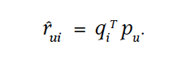
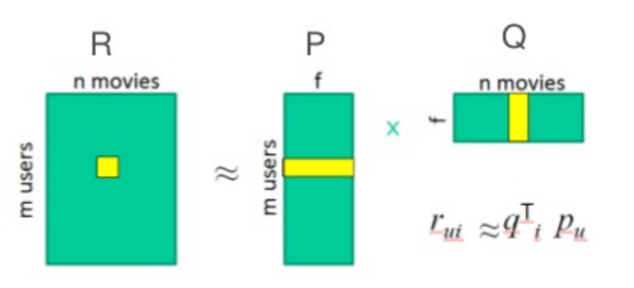
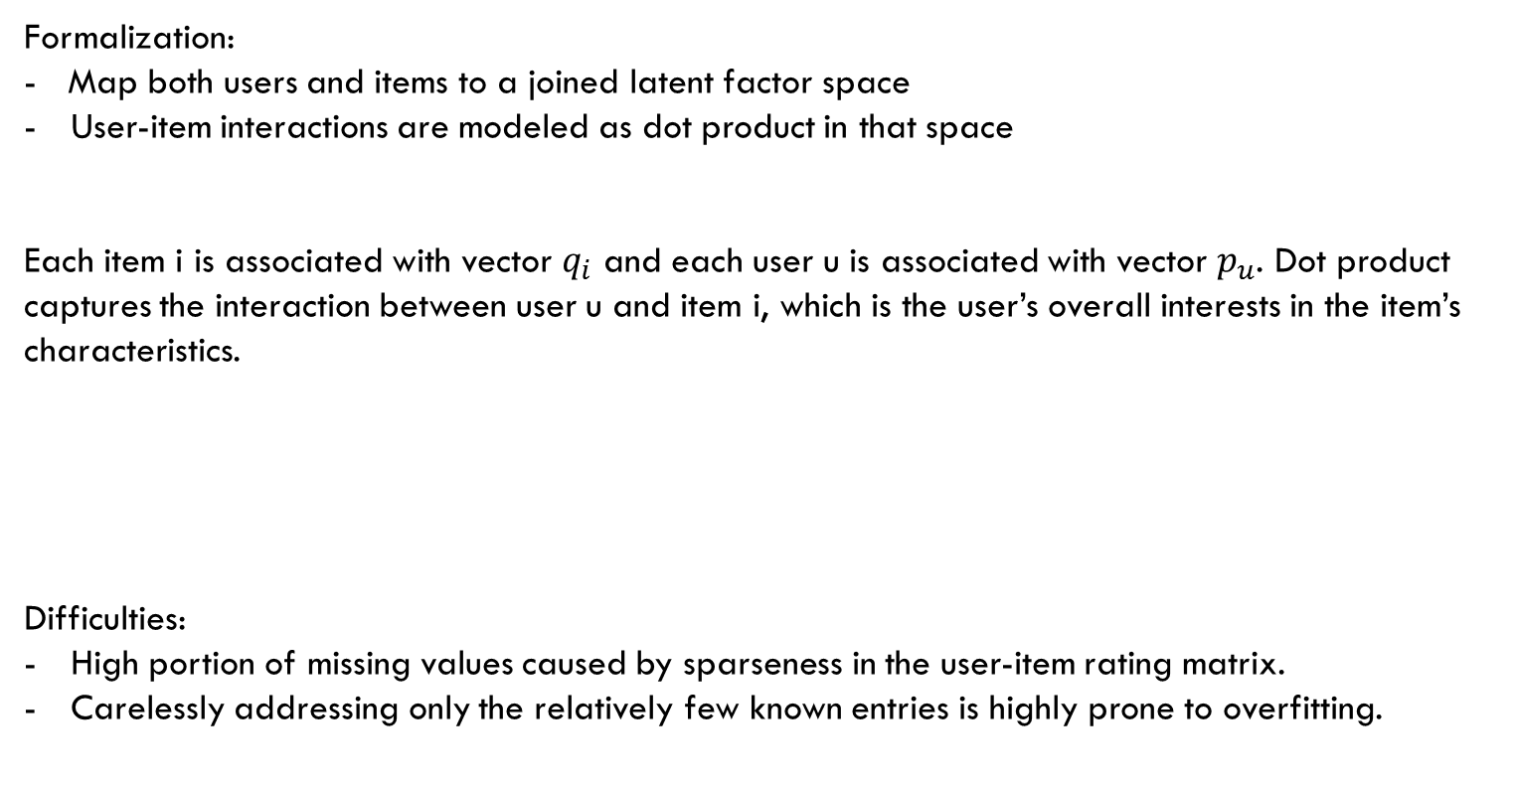
A BASIC Matrix factorization MODEL
Formalization:
- Map both users and items to a joined latent factor space
User-item interactions are modeled as dot product in that space
Each item i is associated with vector $q_{i}$ and each user u is associated with vector $p_{u}$. Dot product captures the interaction between user u and item i, which is the user’s overall interests in the item’s characteristics.
Difficulties:
High portion of missing values caused by sparseness in the user-item rating matrix.
Carelessly addressing only the relatively few known entries is highly prone to overfitting.
Notes:
High portion of missing values caused by sparseness in the user-item rating matrix

Slide 9
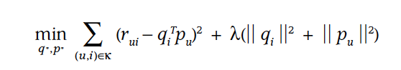
A BASIC Matrix factorization MODEL
To learn the factors and avoid overfitting, the system minimizes the l2 regularized squared error on the set of known rating. The constant lambda controls the extent of regularization.
Learning Algorithms:
1. Stochastic gradient descent
2. Alternating least squares
Notes:
Huazheng: ALS formula.

Slide 10
Stochastic Gradient Decent (SGD):
For each given training case, the system predicts r_{ui} and computes the associated prediction error.
Modifies the parameters according to
the gradient:
Gradient

Slide 11
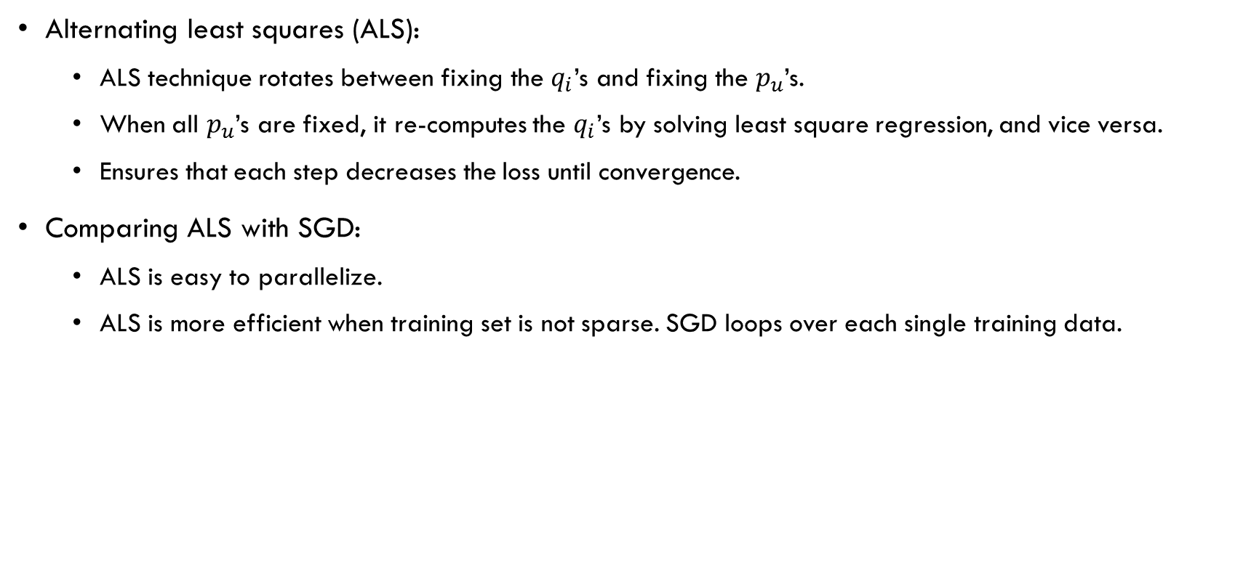
Alternating least squares (ALS):
ALS technique rotates between fixing the $q_{i}$’s and fixing the $p_{u}$’s.
When all $p_{u}$’s are fixed, it re-computes the $q_{i}$’s by solving least square regression, and vice versa.
Ensures that each step decreases the loss until convergence.
Comparing ALS with SGD:
ALS is easy to parallelize.
ALS is more efficient when training set is not sparse. SGD loops over each single training data.

Slide 12
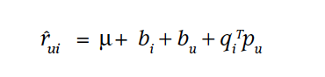
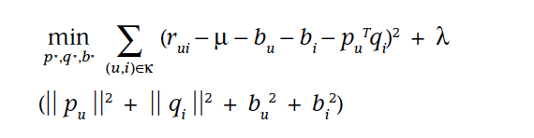
Adding biases
Some products receive higher rating; some users give higher rating. We should identify the user and the item bias.
Re-evaluate the estimation:
Observed rating is broken down into its four components: global average, item bias, user bias, and user-item interaction. The system learns by minimizing the squared error function:
Notes:
u is the overall rating, bi and bu indicate the observed deviation from the average of user u and item I. the last term is the user-item interaction.

Slide 13
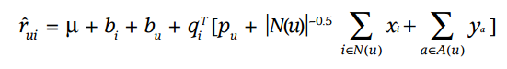
Additional input sources
Many user supply very few ratings, making it difficult to conclude their taste.
Incorporate additional sources of information about the users.
Enhanced user representation (after normalization):
Implicit feedback
eg: purchase history
Know user attributes
eg: gender

Slide 14
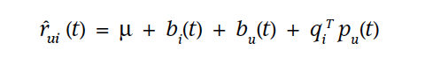
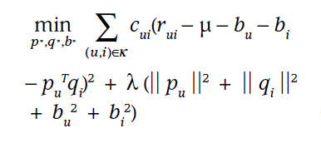
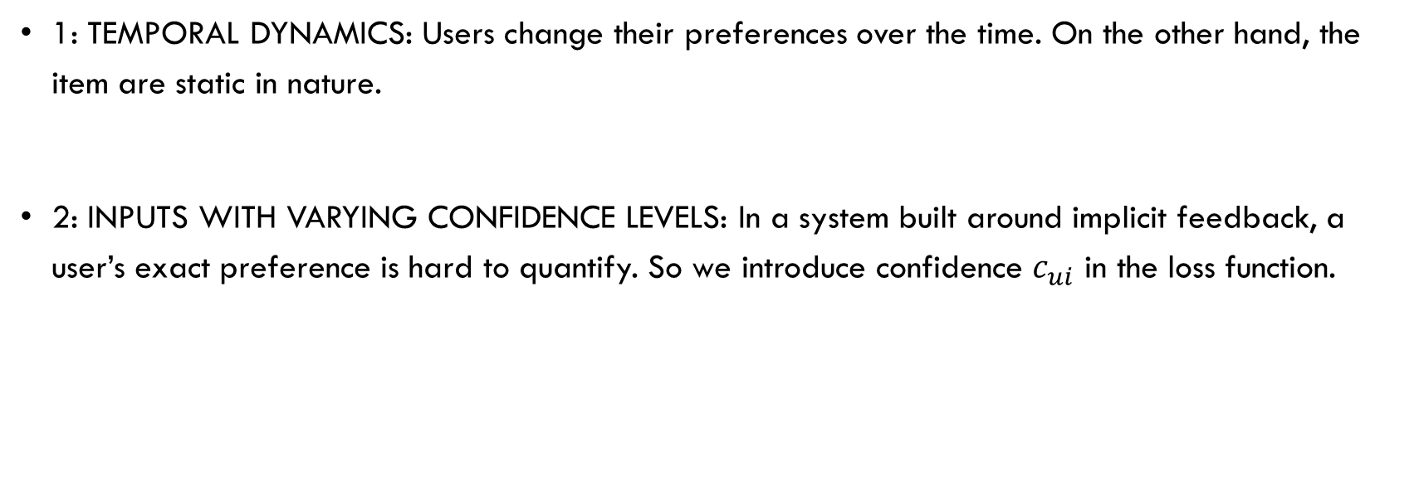
Other aspects
1: Temporal dynamics: Users change their preferences over the time. On the other hand, the item are static in nature.
2: Inputs with varying confidence levels: In a system built around implicit feedback, a user’s exact preference is hard to quantify. So we introduce confidence $c_{ui}$ in the loss function.
Notes:
Temporal Dynamics:
Specifily, an item’s popularity might change over time, Therefore, we treat the item bias bi as a function of time.
Then, the second temporal effect allows users to change their baseline ratings over time, Hence, in these models, the parameter bu is a function of time.
Temporal dynamics go bey ond this; they also affect user preferences and therefore the interaction between users and items. Users change their preferences pu over time.
However, unlike human, items are static in nature, so qi is fixed.
Confidential level:
Confidence can stem from available numerical values that describe the frequency of actions, for example, how much time the user watched a certain show or how frequently a user bought a certain item.
The matrix factorization model can accept varying confidence levels, which let it give less weight to les meaningful observations.

Slide 15
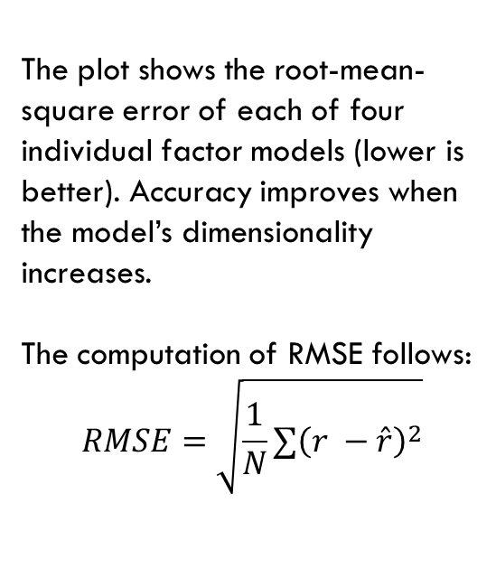
The plot shows the root-mean-square error of each of four individual factor models (lower is better). Accuracy improves when the model’s dimensionality increases.
The computation of RMSE follows:
$$RMSE=\sqrt{\frac{1}{N}∑{\left(r −\hat{r}\right)}^{2}}$$
Notes:
1. Root mean square error
2. Lower is better
3. Accuracy improves when the number of parameters or the complexity of the factor models increase.
4. We can see that temporal dynamic model performed the best, however, the number on each line and what is the temporal dynamics model v1/v2 haven’t been mentioned in paper.

Slide 16
Conclusion
Matrix factorization techniques has become the dominant methodology within collaborative filtering recommender systems.
It offers compact memory-efficient models which the system can learn relatively easily.
It can also integrate naturally many crucial aspects of the data, such as multiple forms of feedback, temporal dynamics and confidence level.

